Slide 1


DevOps Git

Slide 2




Prerequisite
Use Workshop-VM / Workshop-Computer follow the instructions of the Boarding Pass
Visual Studio Code
https://code.visualstudio.com
Git
https://git-scm.com
Competence Team DevTech
Microsoft AL

Slide 3
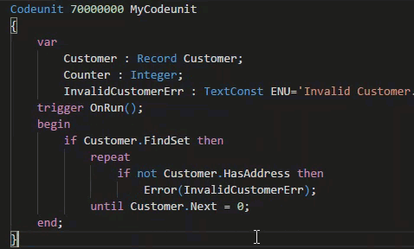
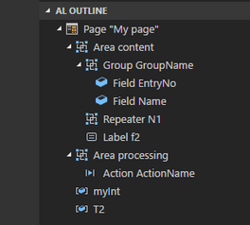
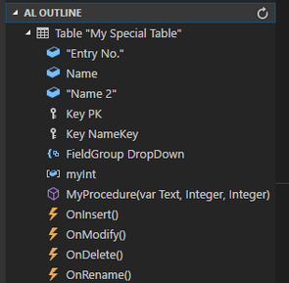
VS Code Useful Extensions
AL Formatter
Indentation
Keyword case style
Sort variable definitions
Readability Guidelines - Spacing and newlines (experimental)
AL Code Outline
Outlining – AL Object Structure
“Create List Page” from Table
“Create Card Page” from Table
al-util
“Rename & Move” Objects
Templates e.g. “Readme.md”

Slide 4


1
Introduction Git
2
Git Commands
AGENDA
3
Git & VS Code
4
Hand On

Slide 5

Git
Introduction
5

Slide 6
Git www.GitHub.com
What is Git?
Distributed version control system
Tracking changes on files
Used for source code management
Strong support for non-linear development
Rapid branching and merging / a branch is only a reference to one commit
Help to coordinate work among multiple people
Distributed development
Local copy of the full development history and changes
Efficient handling of large projects
Very fast and scalable
Remote
Repository
Team
PULL PUSH
PULL PUSH
CLONE
CLONE
Local
Repository Developer 1
Local
Repository
Developer 2

Slide 7
Git & MS Dynamics .../Getting-Started-Git-Basics
Replace In-Db Version Control of Dynamics NAV
Tracking of Changes (What / Where / Who)
File Types
Primary Track changes in TXT-Files!
Binaries supported BUT avoid FOBs
Directories & Files
.git contains the version information metadata of the repository
.gitignore exclude files and directories from Git
Branching
Development within same objects at the same time
Almost automatic merging of changes
Remote
Repository
Team
PULL PUSH
PULL PUSH
CLONE
CLONE
Local
Repository Developer 1
Local
Repository
Developer 2

Slide 8
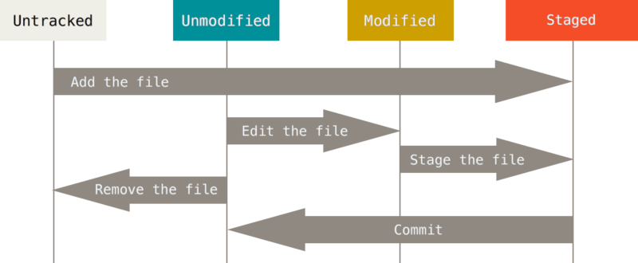
Git – Recording Changes to the Repository
Create Repository
Add Files
no empty Directories
Status: Staged
Commit Changes
Unmodified files
Source: https://git-scm.com/book/en/v2/Git-Basics-Recording-Changes-to-the-Repository

Slide 9
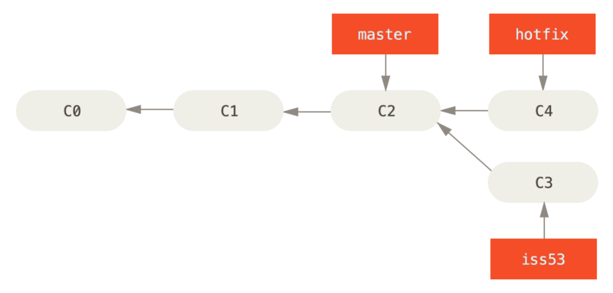
Git – Branches
Create a Branch
Track isolated changes
Switch between Branches
Change the current View of Branch file(s)
Latest tracked Version of Branch file(s)
Merge Branches
Combine the changes of 2 Branches since Fork Commit
Source: https://git-scm.com/book/en/v2/Git-Branching-Basic-Branching-and-Merging

Slide 10

Infrastructure
Git Commands
10

Slide 11
Git .../common-git-commands.html Common Commands Cheat-Sheet
git init
Turns a directory into an empty Git repository
$ git init
git add
Adds files in the to the staging area
$ git add <file or directory name>
git commit
Record the changes made to the files to a local repository
$ git commit -m "Commit message in quotes"
git status
This command returns the current state of the repository
$ git status
git config
Configure the Git Settings e.g. „user.name“ and „user.mail“
$ git config <setting> <command>
git branch
To determine what branch the local repository is on, add a new branch, or delete a branch.
$ git branch <branch_name>
git checkout
To start working in a different branch, use git checkout to switch branches.
$ git checkout <branch_name>

Slide 12
Git .../common-git-commands.html Common Commands / Remote Repository Commands Cheat-Sheet
git merge
Integrate branches together.
$ git merge <branch_name>
git log
Show the chronological commit history for a repository.
$ git log
git remote
To connect a local repository with a remote repository.
$ git remote <command> <remote_name> <remote_URL>
git clone
Create a local working copy of an existing remote repository
$ git clone <remote_URL>
git pull
This pulls the changes from the remote repository to the local computer.
$ git pull <remote_URL/remote_name> <branch>
git push
Sends local commits to the remote repository.
$ git push <remote_URL/remote_name> <branch>

Slide 13

Infrastructure
Git & VS Code
13

Slide 14
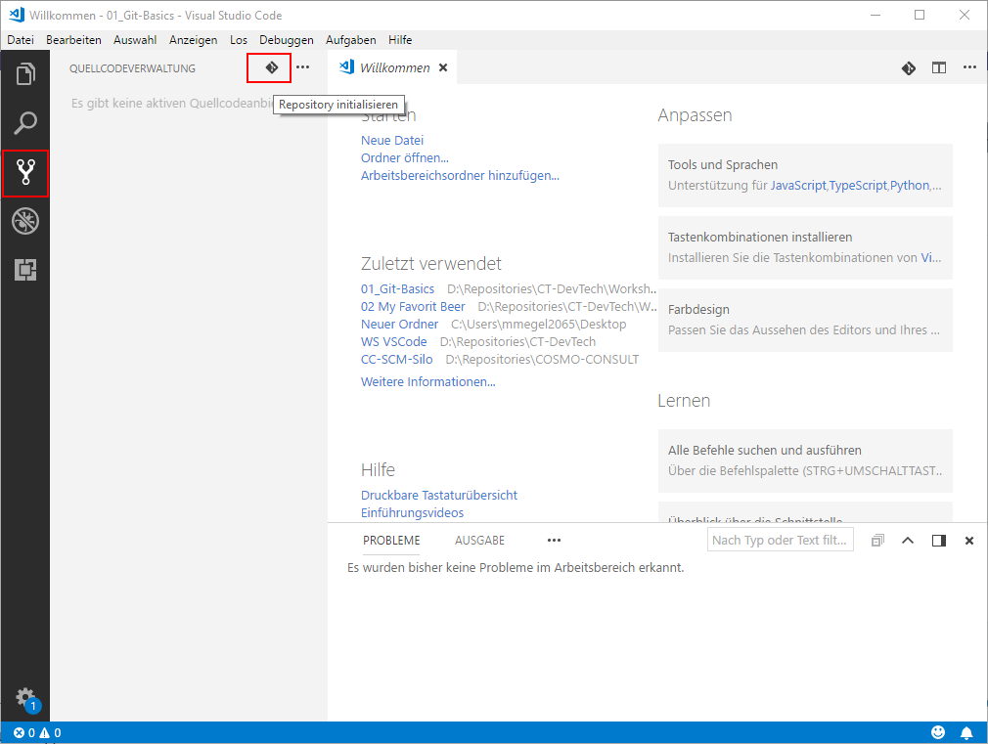
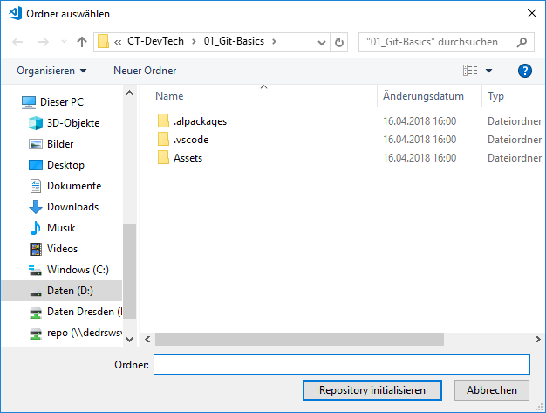
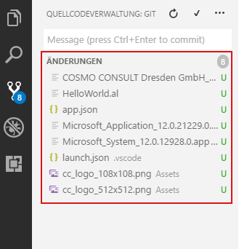
Git with VS Code
Initialize the local Git repository
Select Folder
„Initialize Repository“
Files will be recognized as „Untracked“

Slide 15
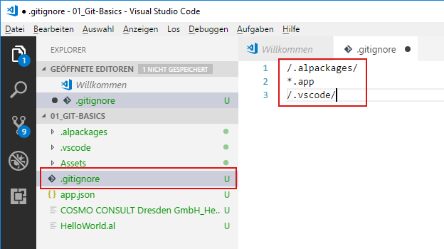
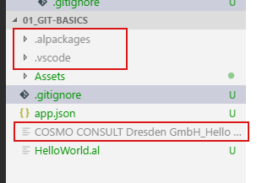
Git with VS Code
Create the “.gitignore” File
Ignore Files & Folders from Repository
Ignored Files
Symbols & Dependencies in “.alpackages” use Download from Server
Package File “*.app” created by compile
Workspace Settings in “.vscode” e.g. “launch.json”

Slide 16
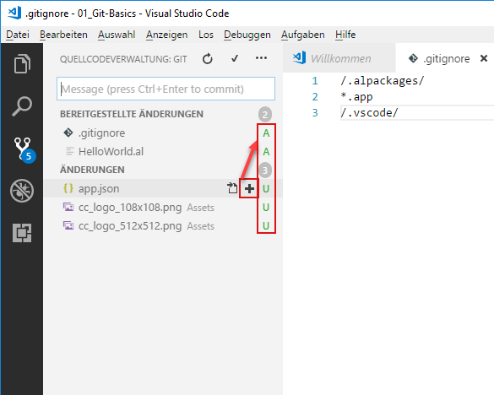
Git with VS Code
Add Files
Mark as „Staged“
Commit
Commit Message
Configure „user.name“ & „user.mail“

Slide 17
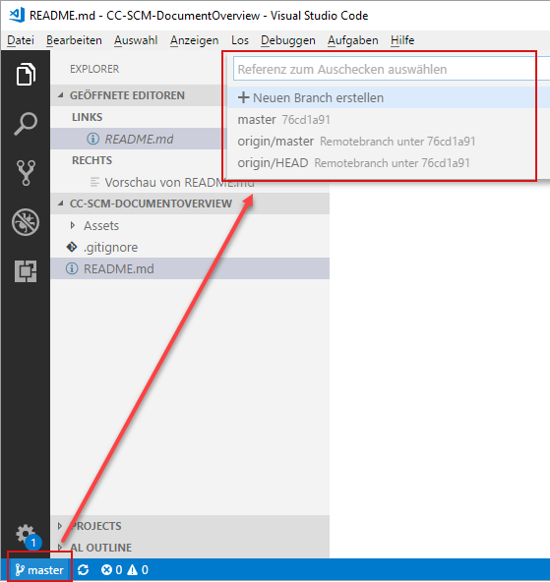
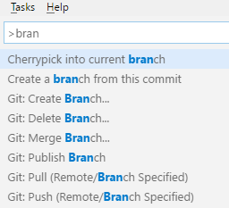
Git with VS Code
Create / Switch Branch
Use Command Palett [Ctrl] + [P] or [F1] → enter „BRANCH…“
Use Status Bar → click on your current Branch e.g. „master“
Pull / Push
Use Command Palett [Ctrl] + [P] or [F1] → enter „PULL…“ / „PUSH…“

Slide 18

Hands On

Slide 19
Git Hands On
Material
COPY the Folder “03-DevOps-Git\Starter” to a local folder e.g. “C:\Workshop\MyStarter\”! (not Git observed)
Project Skeleton „..\03-DevOps-Git\Starter\COSMO-CONSULT-1\”
Project Skeleton „..\03-DevOps-Git\Starter\COSMO-CONSULT-2\”
Project Skeleton „..\03-DevOps-Git\Starter\COSMO-CONSULT-3\”
Prerequisites
Connect to your Workshop VM → use Instructions on your Workshop Boarding Pass
Hand On - Tasks
Achieve common development related tasks with the Git command line
Achieve common development related tasks with the VS Code and the Git Integration
Achieve common development related tasks with the a 3rd Party Tool

Slide 20
Git – Hands On Use the Git command line
Open folder „…\03-DevOps-Git\Starter\01_Git-Basics” in Git Bash / Command Line
Open the folder “01_Git-Basics“ also in VS Code
Init the Repository
Add File(s)
Commit File
Check your Git-Config (Username / User-Email) ☺
Create Branch „feature“
Add or Change File(s) & stage File (git add)
Commit File
Switch between branches „master“ and „feature“
see the difference
Merge branch „feature“ into „master“
$ git init .
$ git add *
$ git commit –m "initial commit"
$ git config user.email "my@emailaddress.com"
$ git config user.name "Jon Doe"
$ git branch "feature"
$ git checkout "feature"
$ git add *
$ git commit –m "comment your changes"
$ git checkout "master"
$ git checkout "master"
$ git merge "feature"

Slide 21
Git – Hands On Use VS Code git integration
Open folder „…\03-DevOps-Git\Starter\02_Git-Basics” in VS Code
Init the Repository
Create a “.gitignore” file to ignore Symbols (“.alpackages”) and the “.vscode” folder and the “.app” file
Add the other project File(s)
Commit File
Check your Git-Config (Username / User-Email) ☺
Create Branch „feature“
Add or Change File(s) & stage File (git add)
Commit File
Switch between branches „master“ and „feature“
see the difference
Merge branch „feature“ into „master“

Slide 22
Git – Hands On Use a 3rd Party Tool (e.g. Smart GIT form syntevo) for your Git workflow
Open the folder „…\03-DevOps-Git\Starter\03_Git-Basics” in VS Code
Add and Init the Repository („…\03-DevOps-Git\Starter\03_Git-Basics”)
Ignore Symbols (“.alpackages”) and the “.vscode” folder and the “.app” file
Add the other project File(s)
Commit File
Check your Git-Config (Username / User-Email) ☺
Create Branch „feature“
Add or Change File(s) & stage File (git add)
Commit File
Switch between branches „master“ and „feature“
see the difference
Merge branch „feature“ into „master“

Slide 23

Q & A
Competence Team DevTech
Channel Microsoft AL

